Slide 1
Windows Booting process -Team 5

Slide 2
Booting Process:
The process of the computer loading the operating system to its memory and prepares it for use.
Types of booting:
Cold boot:
Cold boot is the process of starting a computer from shutdown or a powerless state and setting it to normal working condition.
Warm boot:
A warm boot is typically initiated from the operating system, rather than pressing a button on the computer itself. For example, to perform a warm boot on a Windows system, you may select Shut Down → Restart from the Start Menu.

Slide 3
Stages of Booting process:
BIOS initialization
OS loader
Kernel initialization
Session initialization
Winlogon initialization
Explorer initialization.

Slide 4
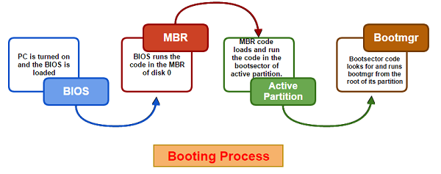
BIOS initialization:

Slide 5
During the BIOS Initialization phase, the platform firmware identifies and initializes hardware devices, and then runs a power-on self-test (POST).
The POST process ends when the BIOS detects a valid system disk, reads the master boot record (MBR), and starts Bootmgr.exe. Bootmgr.exe finds and starts Winload.exe on the Windows boot partition, which begins the OS Loader phase.

Slide 6
OS LOADER:
During the OS Loader phase, the Windows loader (Winload.exe) loads essential system drivers that are required to read minimal data from the disk and initializes the system to the point where the Windows kernel can begin execution.
When the kernel starts to run, the OS loader loads the system registry and additional drivers that are marked as BOOT_START into memory.

Slide 7
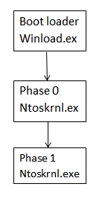
Kernel Initialization:
Kernel acts as a layer between software and hardware.
1. Initialize kernel
2. Initialize hal.dll
3. Start the Debugger
After executing the functions of boot files the control
is passed to Kernel.
ntoskrnl.exe is the kernel file in a Windows machine.
The library file hal.dll helps Kernel to interact with
hardwares.
hal.dll file is machine specific.
Now the drivers for hardwares are loaded from the file
and the Kernel is loaded to primary memory.
Once the kernel is fully initialized it takes over control of the
computer and continues initialization with the file-systems and Processes.

Slide 8
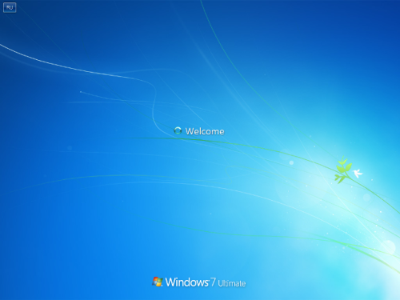
Session initialization:
Loads the subsystem drivers
Loads kernel mode part of windows subsystem
Initialize
Csrss.exe
Create additional paging file
Session 0 Initialization
Wininit.exe
Initialize the registry security
Session 1 & beyond initialization
Winlogon.exe
Creates system environment variable

Slide 9
Winlogon:
A part of the Windows operating system that provides interactive logon support.
Winlogon is designed around an interactive logon model that consists of three parts:
The Winlogon executable.
A Graphical Identification and Authentication dynamic-link library (DLL) referred to as the GINA.
Any number of network providers.
Initializing Winlogon :
When Winlogon initializes, it registers the CTRL+ALT+DEL secure attention sequence (SAS) with the system, and then creates three desktops within the WinSta0(window station object) window station.
Registering CTRL+ALT+DEL makes this initialization the first process, thus ensuring that no other application has hooked that key sequence.
WinSta0 is the name of the window station object that represents the physical screen, keyboard and mouse.

Slide 10
Winlogon desktop :
This is the desktop that Winlogon and GINA use for interactive identification and authentication, and other secure dialog boxes.
Winlogon automatically switches to this desktop when it receives SAS event notification.
Application desktop :
Each time a user successfully logs on, an application desktop is created for that logon session.
The application desktop is also known as the default or user desktop.
This desktop is where all user activity takes place.
Only the system and the interactive logon session have access to it.

Slide 11
Screen saver :
This is the current desktop when a screen saver is running.
If a user is logged on, both the system and the interactive logon session have access to the desktop.
If not only the system has access to the desktop.
GINA
A Graphical Identification and Authentication dynamic-link library (DLL).
The GINA is a replaceable DLL component that is loaded by the Winlogon executable.
The GINA implements the authentication policy of the interactive logon model and is expected to perform all identification and authentication user interactions.

Slide 12
Explorer Initialization :
The Explorer Initialization sub phase begins when Explorer.exe starts.
During Explorer Initialization, the system creates the desktop window manager (DWM) process, which initializes the desktop and displays it for the first time.
Phase Activities in Explorer Initialization :
The list of activities for this phase are
Explorer.exe starts
Desktop Window Manager starts
The desktop is displayed for the first time
Auto-start (Run-keys) applications are launched

Slide 13
RunOnce Registry Key:
Windows support a registry key, RunOnce, which can be used to specify commands that the system will execute one time and then delete.
In the absence of RunOnce applications, most of the time in this phase should be spent initializing the Explorer process.
Explorer reads a number of libraries and data files into memory during its initialization process.

Slide 14
SAFE BOOT Options
Safe Mode Is A Special Way For Windows To Load When There Is A System-critical Problem That Interferes With The Normal Operation Of Windows.
The purpose of Safe Mode is to allow you to troubleshoot Windows and try to determine what is causing it to not function correctly.
Once you have corrected the problem, then you can reboot and Windows will load normally.

Slide 15
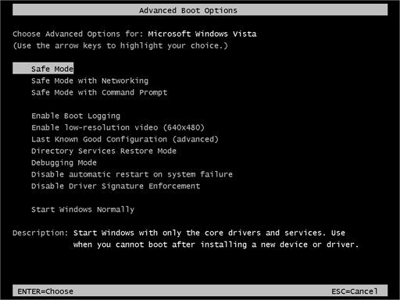
SAFE Modes
Safe Mode starts Windows with only core drivers and services.
Safe Mode with Networking starts windows with only core drivers, plus networking support.
Safe Mode with Command Prompt is identical to Safe Mode except that Command Prompt is loaded as the default user interface instead of Explorer. Choose Safe Mode with Command Prompt if you've tried Safe Mode but the taskbar, Start screen, or Desktop doesn't load properly

Slide 16
Steps to be followed to enter safe mode
Immediately after the computer is powered on or restarted (usually after you hear your computer beep), tap the F8 key in 1 second intervals.
After your computer displays hardware information and runs a memory test, the Advanced Boot Options menu will appear.
Use the arrow keys to select Safe Mode or Safe Mode with Networking and press ENTER.
When you are finished troubleshooting, repeat steps 1-3 and select Start Windows Normally to return to your normal Windows configuration.

Slide 17
There are several things that happen when Windows boots in Safe Mode:
Safe Mode does not run the autoexec.bat or config.sys files.
Most device drivers are not loaded.
Instead of the normal graphics device driver, Safe Mode uses standard VGA graphics mode. This mode is supported by all Windows-compatible video cards.
Himem.sys, which is normally loaded as part of the config.sys script, is loaded with the /testmem:on switch. This switch tells the computer to test the extended memory before continuing.
Safe Mode checks the msdos.sys file for information on where to find the rest of the Windows files. If it finds the files, it proceeds to load Windows in Safe Mode with the command win /d:m. If it does not find the Windows files, it will run command.com to bring up a C: prompt.

Slide 18
Windows boots using a batch file called system.cb instead of the standard system.ini file. This file loads the Virtual Device Drivers (VxDs) that Windows uses to communicate with the standard parts of the computer.
Windows now loads the regular system.ini file plus win.ini and Registry settings. It skips the [Boot] (except for the shell and device lines) and [386Enh] sections of system.ini and does not load or run any programs listed in win.ini.
The Windows desktop loads up in 16 colors and at a resolution of 640 x 480 with the words "Safe Mode" in each corner.

Slide 19
Windows Booting and Linux Booting

Slide 20
Windows Booting Process
The booting process in windows is very easy just like its user friendly features. There are four basic steps are there in Windows operating system while booting. The first process starting when you turn on your computer is BIOS i.e., Basic Input Output System.

Slide 21
Windows booting Steps:
POST
MBR
Other Partition And O .S detction
Other Booting Supporting Files

Slide 22
POST :
POST stands for Power On Self- Test, which is very critical step, where hardware configuration and detection has been perform, by looking and listening the errors and diagnosis reports e.g. beeps codes.
MBR: (MASTER BOOT RECORD)
BIOS will look for the Booting Priority, like from where the computer will get the operating system e.g. from hard-disk, floppy disk, or network. This record in booting process is called MBR (Master Boot Record) which is stored on first sector of the hard disk from where the operating system start it’s loading in Primary memory.

Slide 23
MBR(Master Boot Record)
A master boot record (MBR) is a special type of boot sector at the very beginning of partitioned computer mass storage devices like fixed disks .
The MBR holds the information on how the logical partitions, containing file systems are organized.
The MBR also contains executable code to function as a loader for the installed operating system.
The size of MBR is less than 512 bytes.

Slide 24
Partition and OS detection:
The BIOS knows the MBR and Booting Partition where the operating system loads the small system software called KERNEL into main memory.
NTLDR (abbreviation of NT Loader) is the boot loader for all releases of Windows NT operating system up to and including Windows XP and Windows Server 2003.
NTLDR (NT Loader) will load the partitions in the computer system and try to identify other partition other than primary partitions.

Slide 25
other booting support files:
Other important booting support file like win.sys, NTOSKERNEL.exe, HAL.DLL these file are help in different system software installation for which the application oriented environment has to get implemented.
ntoskrnl.exe also known as kernel image, responsible for various system services such as hardware virtualization, process and memory management.

Slide 26
Linux Booting Process:
The booting process in Linux is quite different than windows except the BIOS and MBR features. There are four basic steps in Linux operating system while booting. The first process starting when you turn on your computer is BIOS i.e., Basic Input Output System

Slide 27
Linux Booting Steps:
POST
MBR
GRUB
Other Booting Supporting Files

Slide 28
GRUB
GRUB (Grand Unified Boot Loader) or Li Lo (Linux Loader) which try to load the operating system feature form the supporting resources
one of the most important function of the GRUB is load the Kernel into the memory during the booting by loading Linux RC which stands for Linux Run Command for initializing the basic hardware for necessary during the booting process
The final task of GRUB is to initialize the file system mounting though INIT root directory by mounting the initial file system for further activity of loading other supporting file of Linux operating System.

Slide 29
Other booting supporting files:
Other important booting support file like /sbin//init, These file help in different system software installation for which the application oriented environment has to get implemented, which help to create the GUI or Console base environment for the user to use the operating system.
The /sbin/init program (also called init ) coordinates the rest of the boot process and configures the environment for the user.

Slide 30
Thank You

